Slide 1
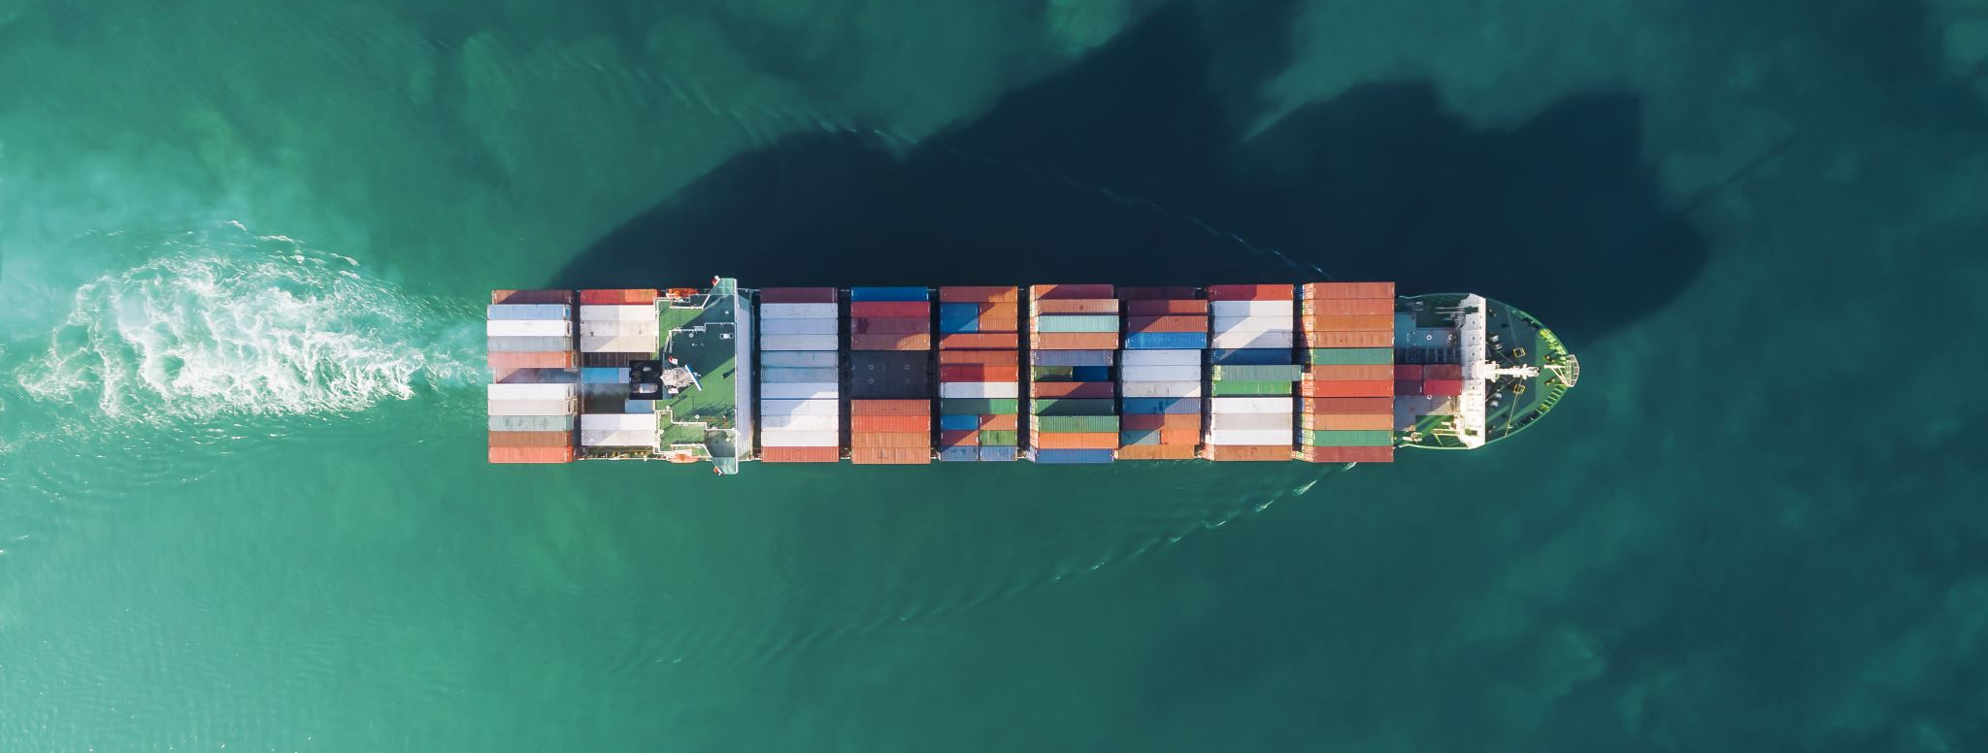
Paolo Laquidara Srl
Ships and forwardings agents since 1898

Slide 2
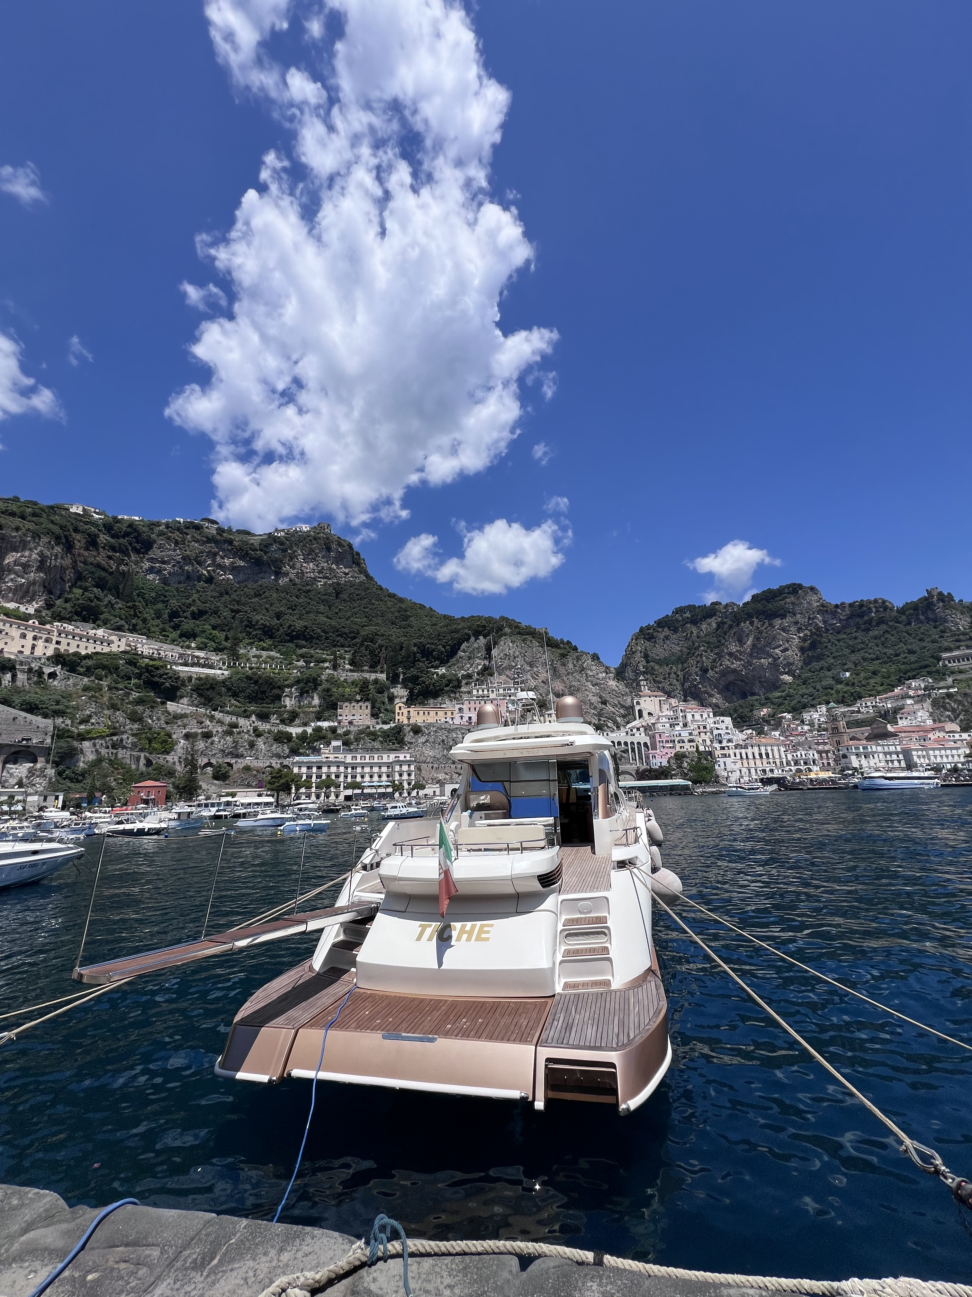
Our Services
-Shipping agency
-Husbandry agency
-Custom brokers
-Shipchandlers
-Crew manning
-Recruitment
-Sted operator
-Yachting services
-Police formalities
-Import/export
-Seamen Visas
-Dredging
-Project cargos
And more over…
In all italian ports

Slide 3
Since 1898 passing through 5 generations of shipping agents
Mr. Paolo Laquidara founded the agency in 1898 in the town of Milazzo, a natural and historical port in the northern side of Sicily Island. As port agent he assisted small boats for meal provisions, concretes, oil and spares directed to Eolian islands (7 vulcanic islands located exactly in front of Milazzo). Passing through the 1900 the activity changed with the industrial progress: from steam commercial vessels passing trough military vessels, then small passengers ships for emigrations from south Italy to America and Australia.
So we started direct connections with important owners like Micoperi and Maraldi who believed in Laquidara’s family for the construction of the Milazzo refinery by sea in 1962. The biggest in europe at that time, splitted beetwen Eni and Q8 owners. This event took us in the oil,gas and chemical tankers business. We changed with time, learning and moving the sea business through the mediterranean sea for the best world owners and charters.
Commercial but also touristic progress of the port, permitted the entrance of a new reality in the sea business. Speedy boats to eolian islands, Mini cruise, yachts and Mega yachts in the biggest sicilian marinas, passenger ships owned by Laquidara brothers (Andrea and Angelo) were a must. A sector in continuos growing that opened the ship chandling chapter and full assistance 24/07.
We started facing the RoRo Vessel world becoming agents of the major roro companies like Iveco, Stellantis and Ford brands. A continuos grow through more then 120 years of activity.

Slide 4
Our Team
Agency nowadays:
Andrea Laquidara: Chairman
Angelo Laquidara: Chairman
Paolo Laquidara: Ceo
Maria Bartuccio: Operational manager and custom Operations leader
Gisella Cuciti: Chief Administration dept. and Operational manager
Giusi Marte: Operational manager and Sted operator
Captain Omar Laquidara: bridge crew recruitment
Chief Eng Francesco Buta: engine crew recruitment
Never understimate the importance of local knowledge
THINK GLOBAL
ACT LOCAL

Slide 5
Where we work:
As general agents we work in all Italian and Maltese ports thanks to our nets of agencies.
Genova + Savona (and Vado Ligure)
Livorno
Civitavecchia
Fiumicino
Napoli
Salerno
Gioia Tauro
Vibo Marina
Sicilia (all ports + Eolian Islands)
Malta (all ports + OPL)
Vasto + Ortona
Venezia
Trieste
Ravenna
Brindisi

Slide 6
Our Mission

Slide 7
We sail through the sea business changes
Increase our portfolio of owners and charters. The real ‘bunker’ that move our company
An historic agency who looks to the future
Fix every vessels problem becoming the main landmark in Sicily for the sea business
Oil, gas and chemical tankers
Tugs boat
Barges
Ro ro vessels
Passenger ships
Pleasure, mega and super yachts
Cruise ships
Project cargo
Dry cargo
And EVERY FLOATING STUFF, WE ARE WAITING FOR YOURS.
Be ready for every kind of call. Be ready for any type of vessel and his own needs.
No waste time. Owner time is money goes. Shortest time + quality service is our mantra.

